Slide 1
Spacecraft Launch Vehicles
Introduction to Space Systems and Spacecraft Design
Space Systems Design
Some Slides by Dr. J. Cutler – Univ. of MI

Slide 2
Spacecraft Launch Vehicles
Where do you want to go?
Near earth orbit types
  LEO – low earth orbit – 350-1200 km altitude
  MEO – medium earth orbit – 10k km – 25k km altitude
  GEO – geostationary orbit – 36k km altitude
  GEO – geostationary – inclined – 36k km altitude
  Moly (Molniya) – elliptic – 40k km apogee, 5k km perigee?
Other attributes of orbits
  Inclination - angle of the orbit plane above the equator
  going from south to north
  Eccentricity – circular or elliptic orbit
  Equator crossing time – defines time for pass predictions
Introduction to Space Systems and Spacecraft Design
Space Systems Design
Some Slides by Dr. J. Cutler – Univ. of MI

Slide 3
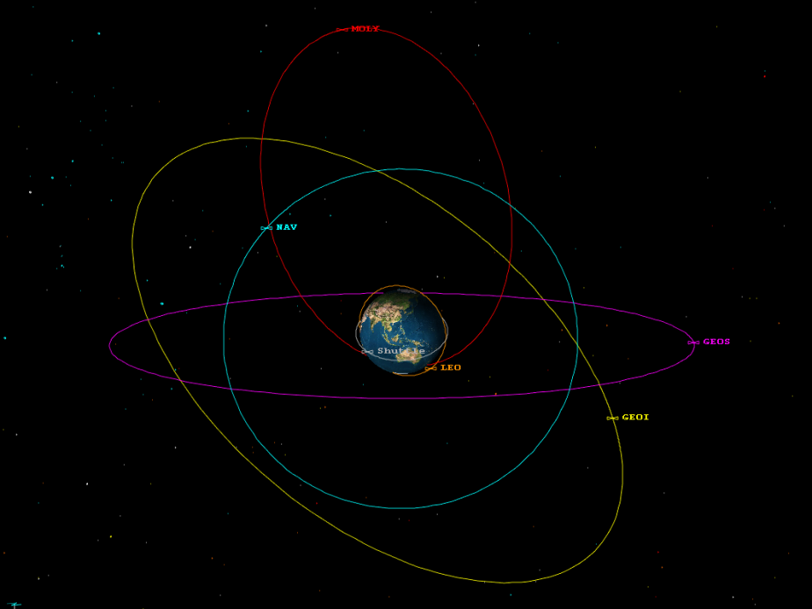
Spacecraft Launch Vehicles
Introduction to Space Systems and Spacecraft Design
Space Systems Design
Some Slides by Dr. J. Cutler – Univ. of MI

Slide 4
Spacecraft Launch Vehicles
Launch Companies – earth orbiting
US
  Lockheed Martin (Atlas)
  Boeing (Delta)
    Now combined into United Launch Alliance
  Space Exploration – SpaceX (Falcon)
  NASA – space shuttle
  Orbital Sciences (Pegasus, Taurus, Minotaur IV)
  Others trying
  ??
Other Countries
  Russians
  ESA – European Space Agency
  India
  China
  Pakistan?
  ??
Introduction to Space Systems and Spacecraft Design
Space Systems Design
4
Some Slides by Dr. J. Cutler – Univ. of MI

Slide 5
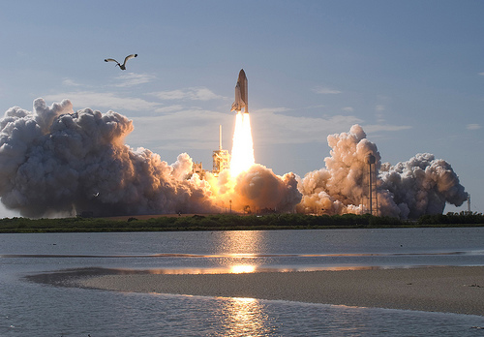
Spacecraft Launch Vehicles
Space Shuttle Launch
Introduction to Space Systems and Spacecraft Design
Space Systems Design
Some Slides by Dr. J. Cutler – Univ. of MI

Slide 6
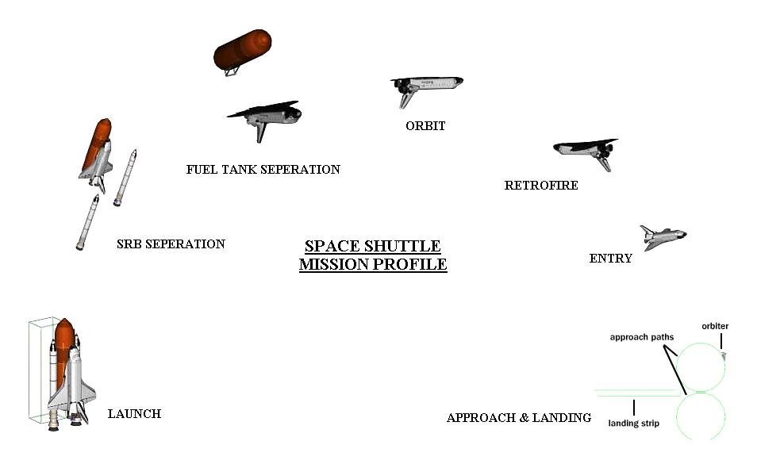
Spacecraft Launch Vehicles
General Launch, Orbit & Deorbit Profile
Introduction to Space Systems and Spacecraft Design
Space Systems Design
Some Slides by Dr. J. Cutler – Univ. of MI

Slide 7
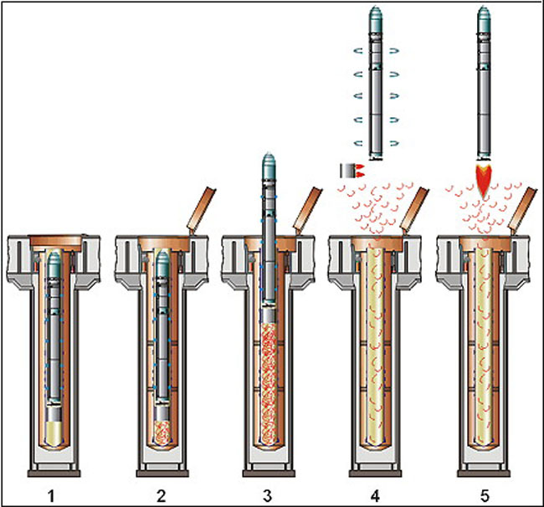
Spacecraft Launch Vehicles
Russian converted ICBM from missile silo
Dnepr
Introduction to Space Systems and Spacecraft Design
Space Systems Design
Some Slides by Dr. J. Cutler – Univ. of MI

Slide 8
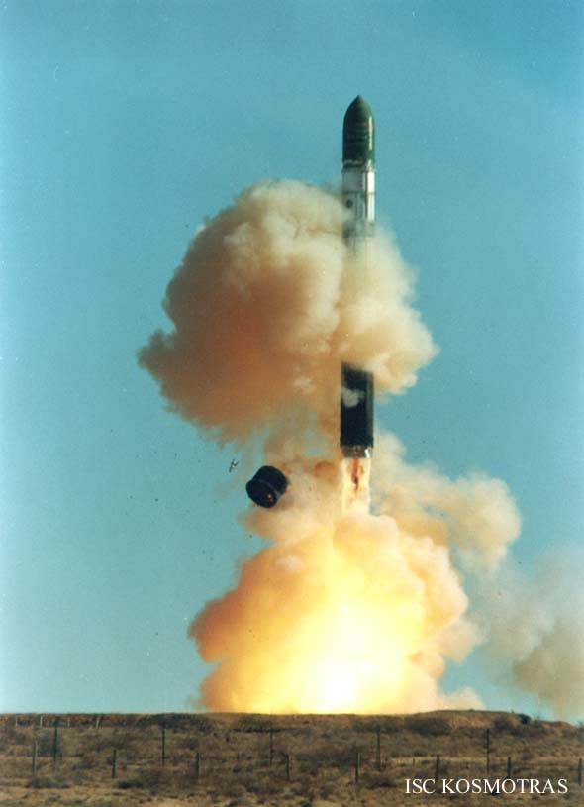
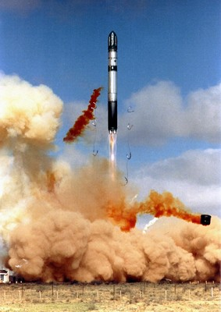
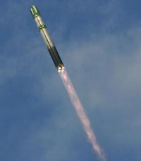
Spacecraft Launch Vehicles
Russian converted ICBM from missile silo
Introduction to Space Systems and Spacecraft Design
Space Systems Design
Some Slides by Dr. J. Cutler – Univ. of MI

Slide 9
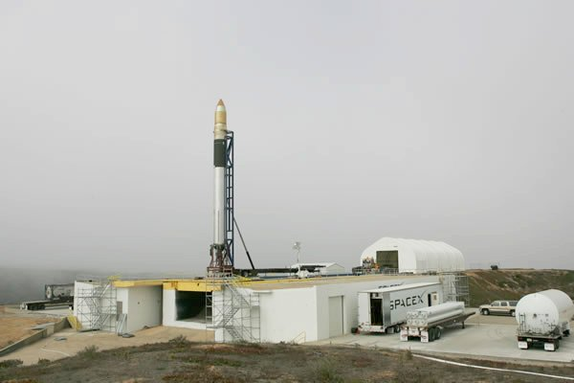
Spacecraft Launch Vehicles
SpaceX Falcon Launch
Introduction to Space Systems and Spacecraft Design
Space Systems Design
Some Slides by Dr. J. Cutler – Univ. of MI

Slide 10
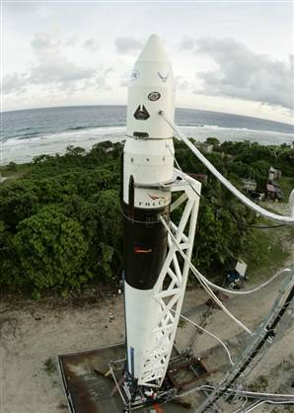
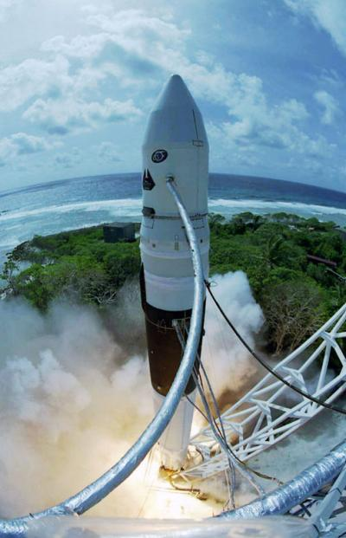
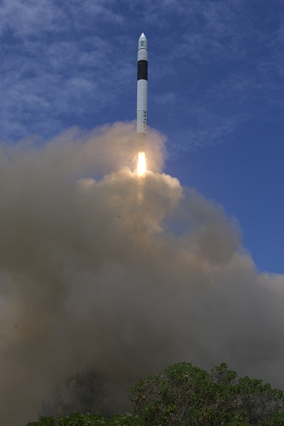
Spacecraft Launch Vehicles
SpaceX Falcon Launch
Introduction to Space Systems and Spacecraft Design
Space Systems Design
Some Slides by Dr. J. Cutler – Univ. of MI

Slide 11
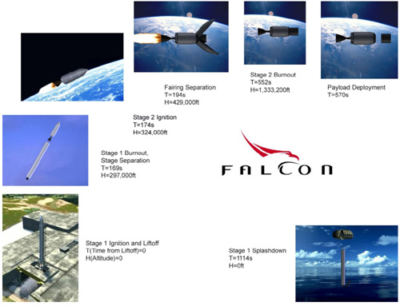
Spacecraft Launch Vehicles
SpaceX Falcon Launch Profile
Introduction to Space Systems and Spacecraft Design
Space Systems Design
Some Slides by Dr. J. Cutler – Univ. of MI

Slide 12
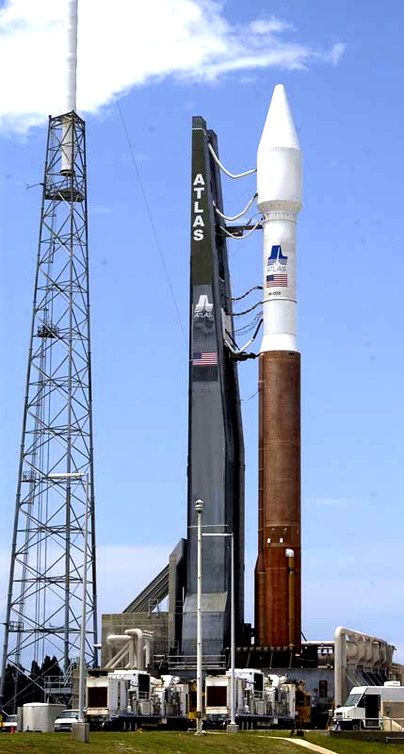
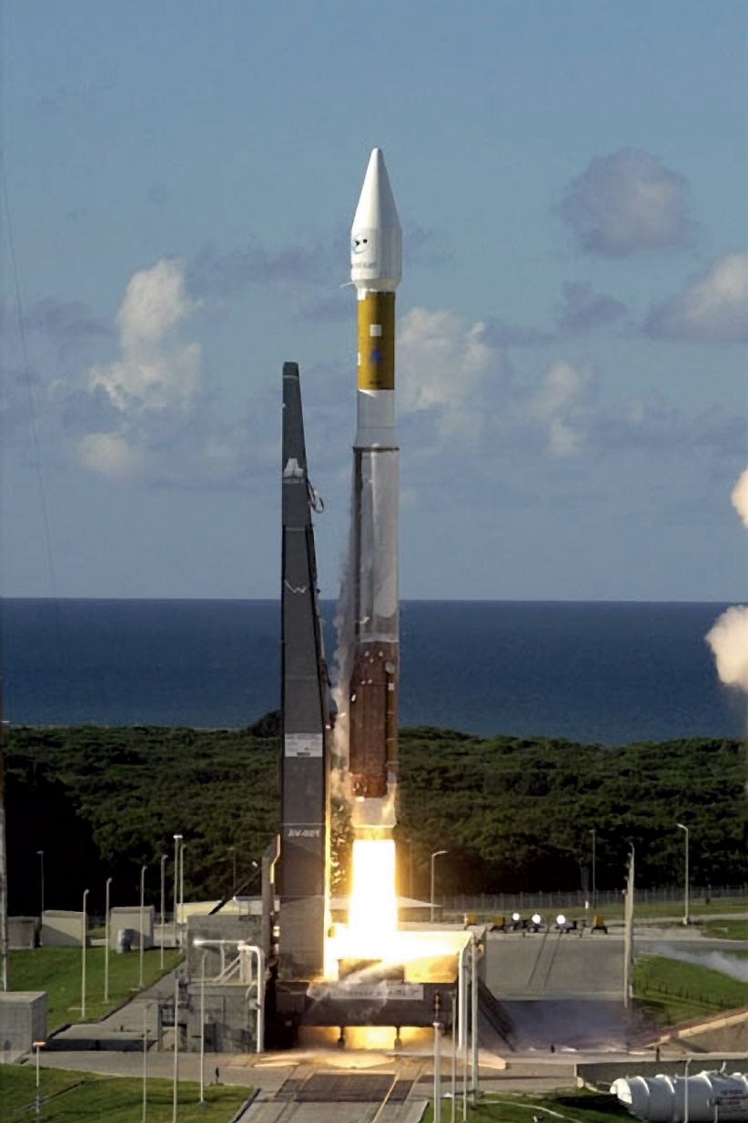
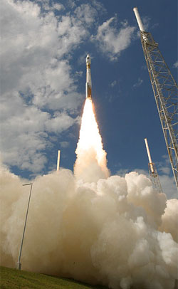
Spacecraft Launch Vehicles
Atlas Launch
Introduction to Space Systems and Spacecraft Design
Space Systems Design
Some Slides by Dr. J. Cutler – Univ. of MI

Slide 13
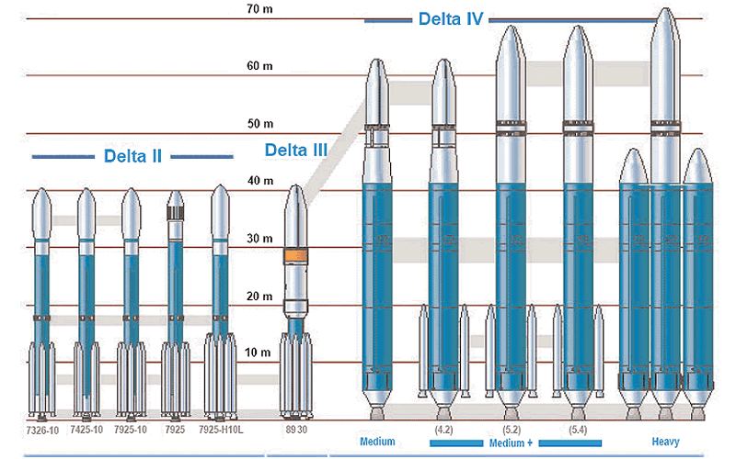
Spacecraft Launch Vehicles
Rocket Configurations
Introduction to Space Systems and Spacecraft Design
Space Systems Design
Some Slides by Dr. J. Cutler – Univ. of MI

Slide 14
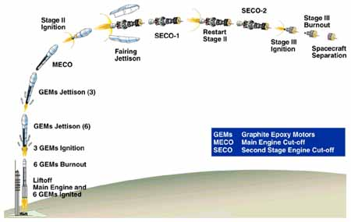
Spacecraft Launch Vehicles
Delta Launch Profile
Introduction to Space Systems and Spacecraft Design
Space Systems Design
Some Slides by Dr. J. Cutler – Univ. of MI

Slide 15
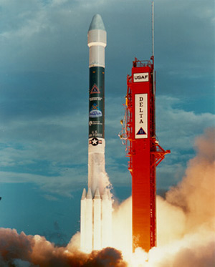
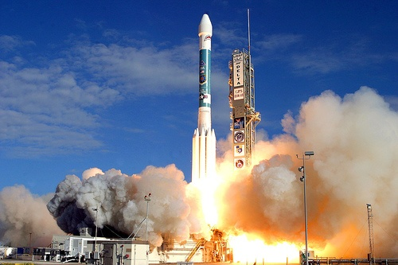
Spacecraft Launch Vehicles
Delta Launches
Introduction to Space Systems and Spacecraft Design
Space Systems Design
Some Slides by Dr. J. Cutler – Univ. of MI

Slide 16
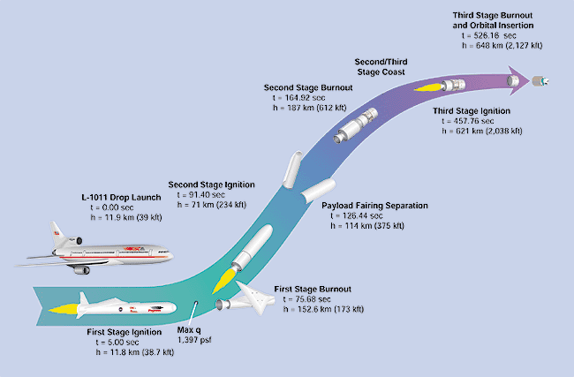
Spacecraft Launch Vehicles
Orbital Sciences – Pegasus Launch Profile
Introduction to Space Systems and Spacecraft Design
Space Systems Design
Some Slides by Dr. J. Cutler – Univ. of MI

Slide 17
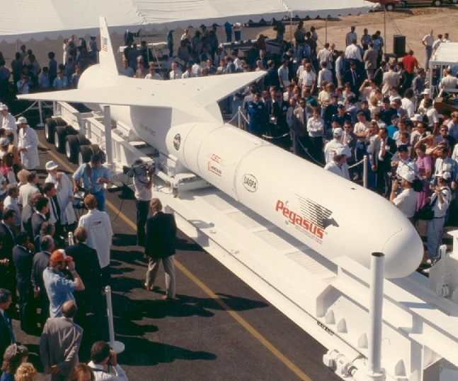
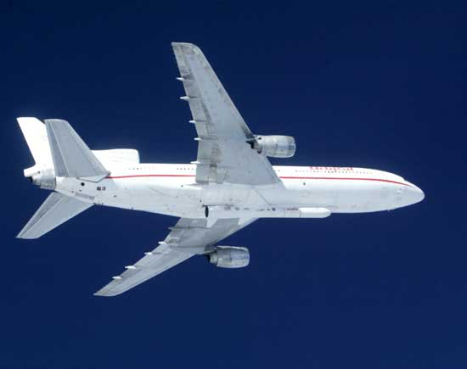
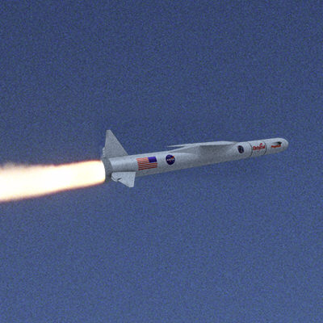
Spacecraft Launch Vehicles
Orbital Sciences - Pegasus
Introduction to Space Systems and Spacecraft Design
Space Systems Design
Some Slides by Dr. J. Cutler – Univ. of MI

Slide 18
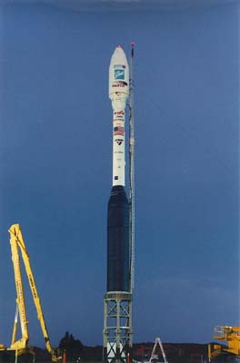
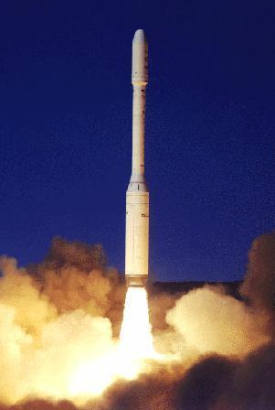
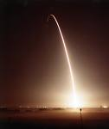
Spacecraft Launch Vehicles
Orbital Sciences - Taurus
Introduction to Space Systems and Spacecraft Design
Space Systems Design

Slide 19
Spacecraft Launch Vehicles
ESPA
Secondary Launches
Introduction to Space Systems and Spacecraft Design
Space Systems Design

Slide 20
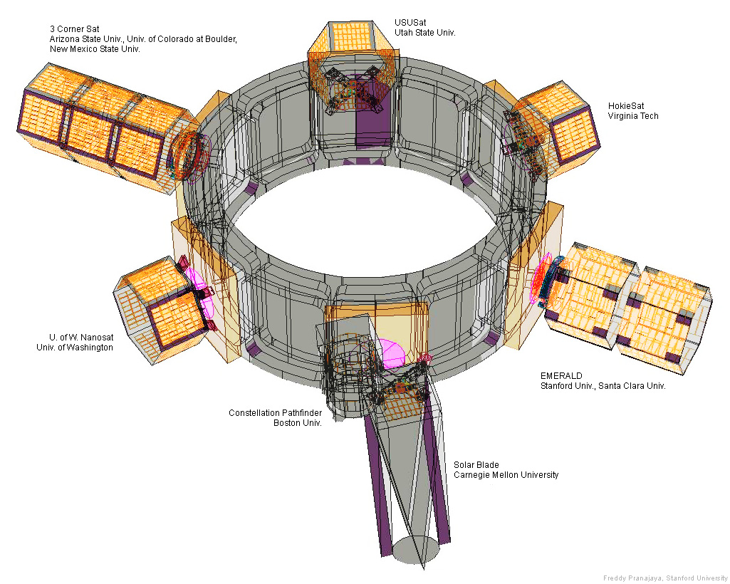
Spacecraft Launch Vehicles
ESPA
Nanosat Program Secondary Launches
Introduction to Space Systems and Spacecraft Design
Space Systems Design

Slide 21
Spacecraft Launch Vehicles
Where can you put your satellite on a rocket when you want it launched?
Introduction to Space Systems and Spacecraft Design
Space Systems Design
Some Slides by Dr. J. Cutler – Univ. of MI

Slide 22
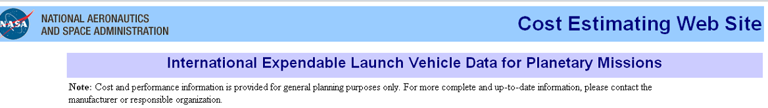
http://cost.jsc.nasa.gov/ELV_INTL.html
Dnepr
http://www.npointercos.jp/DneprLV.html
http://www.scribd.com/doc/16979006/Minotaur-IV-Launch-Vehicle-Users-Guide
Introduction to Space Systems and Spacecraft Design
Space Systems Design

Slide 23
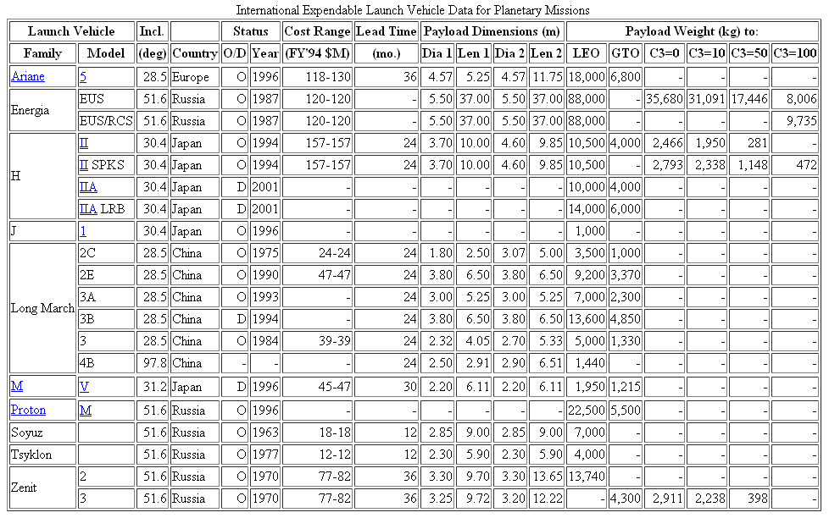
Spacecraft Launch Vehicles
Introduction to Space Systems and Spacecraft Design
Space Systems Design

Slide 24
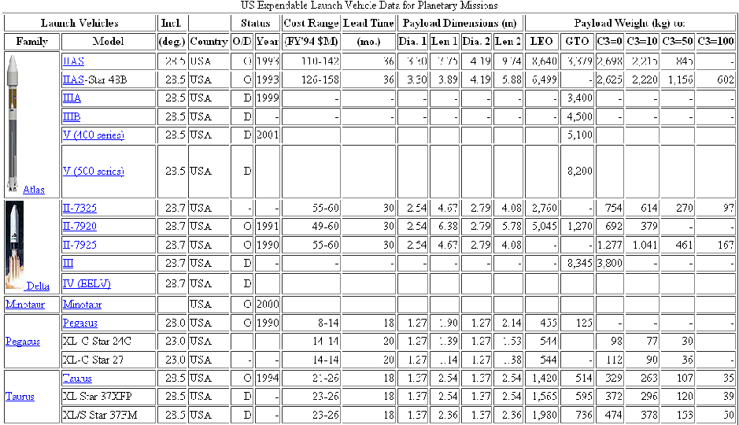
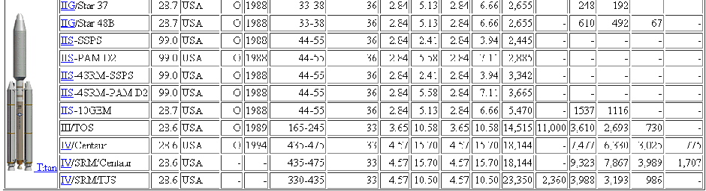

Slide 25
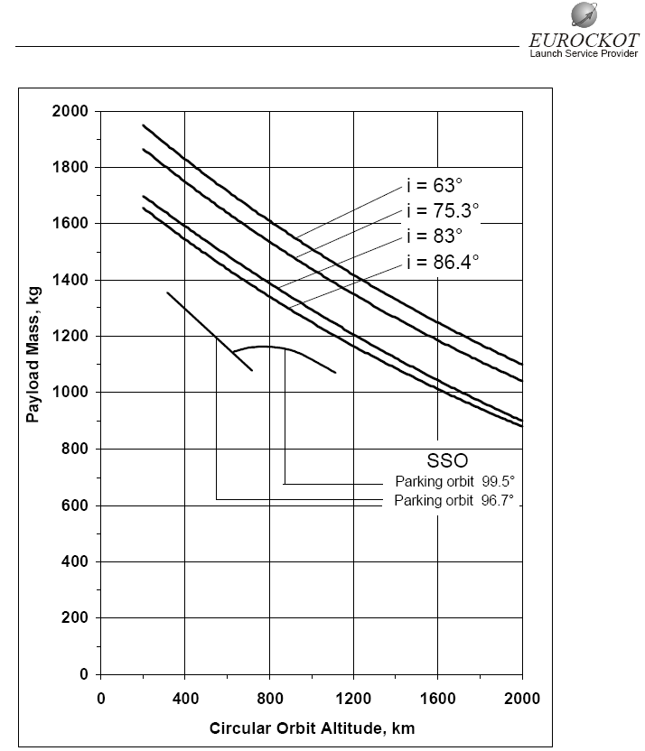
Spacecraft Launch Vehicles
Introduction to Space Systems and Spacecraft Design
Space Systems Design

Slide 26
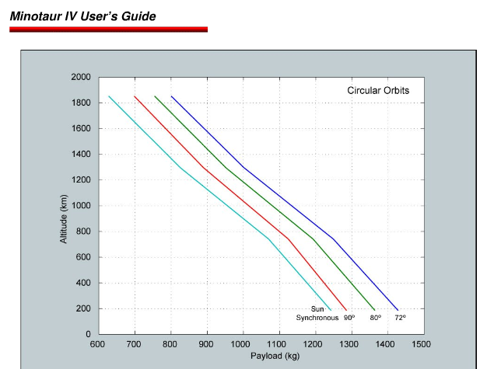
Spacecraft Launch Vehicles
Introduction to Space Systems and Spacecraft Design
Space Systems Design

Slide 27

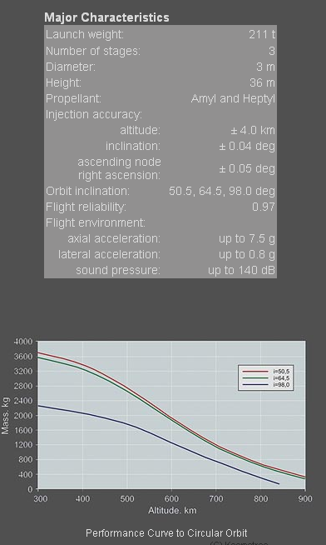
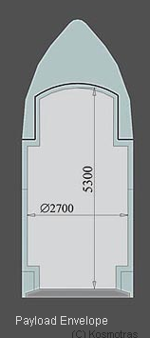
Spacecraft Launch Vehicles
Introduction to Space Systems and Spacecraft Design
Space Systems Design

Slide 28
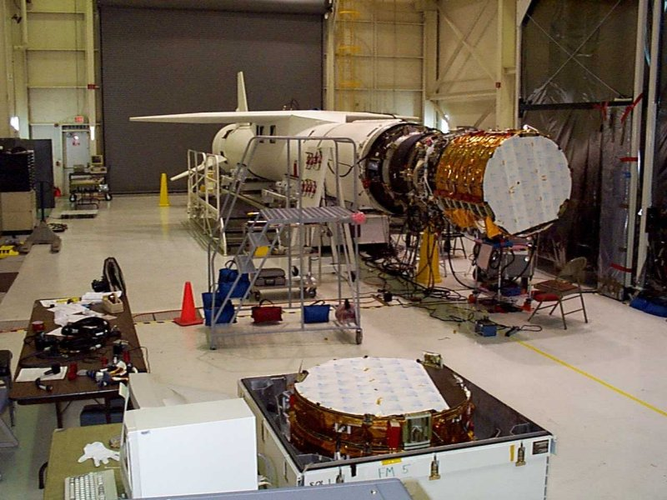
Spacecraft Launch Vehicles
Pegasus Orbcomm Integration
Introduction to Space Systems and Spacecraft Design
Space Systems Design
Some Slides by Dr. J. Cutler – Univ. of MI

Slide 29
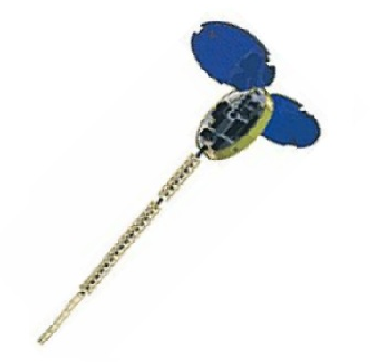
Spacecraft Launch Vehicles
Orbcomm after launch
Store & forward for
messages
Introduction to Space Systems and Spacecraft Design
Space Systems Design
Some Slides by Dr. J. Cutler – Univ. of MI

Slide 30
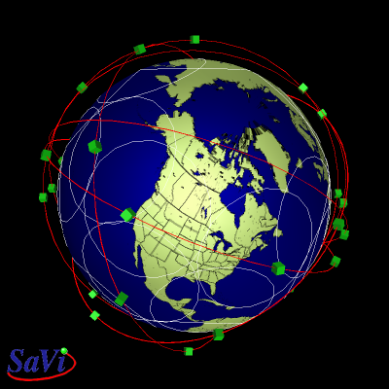
Spacecraft Launch Vehicles
Orbcomm Satellite Constellation
Introduction to Space Systems and Spacecraft Design
Space Systems Design
Some Slides by Dr. J. Cutler – Univ. of MI

Slide 31
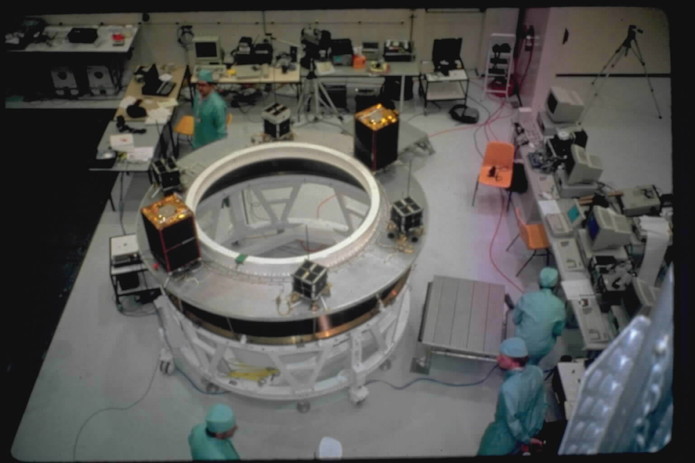
Spacecraft Launch Vehicles
Mounting on Ariane ASAP ring
Introduction to Space Systems and Spacecraft Design
Space Systems Design
Some Slides by Dr. J. Cutler – Univ. of MI

Slide 32
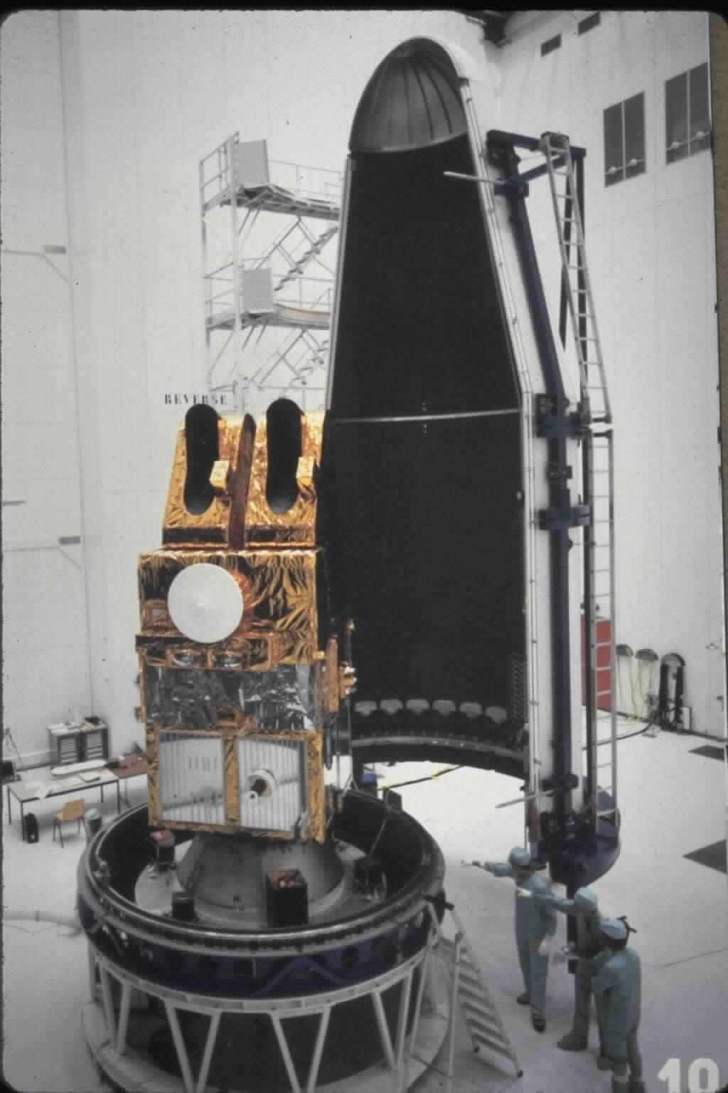
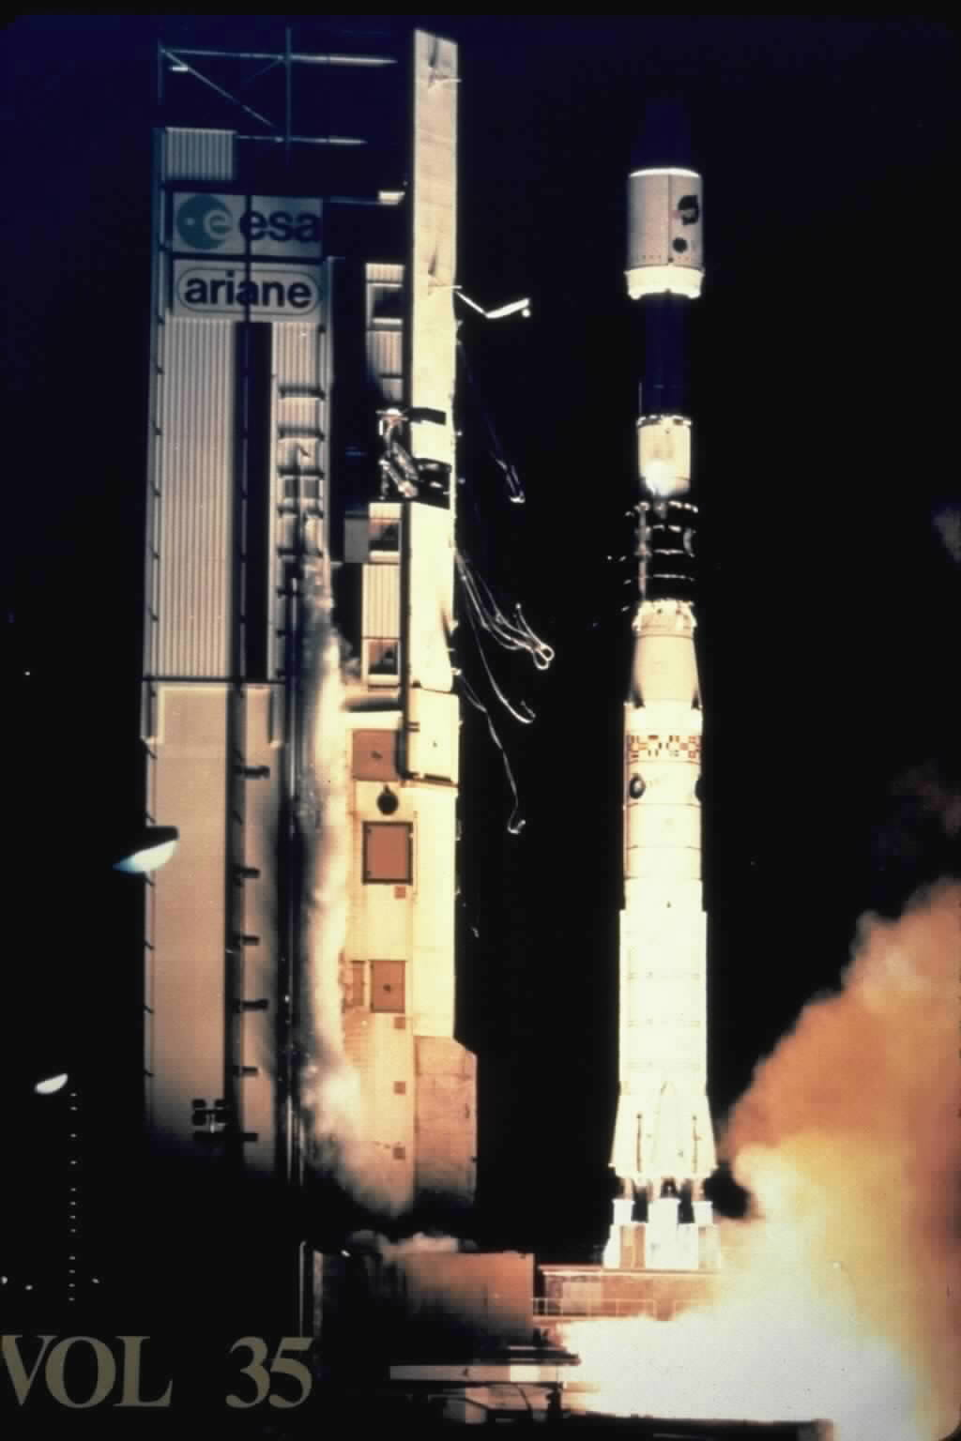
Spacecraft Launch Vehicles
Mounting Faring & launch on Ariane IV
Introduction to Space Systems and Spacecraft Design
Space Systems Design
Some Slides by Dr. J. Cutler – Univ. of MI

Slide 33
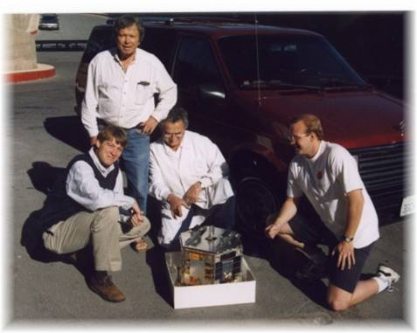
Spacecraft Launch Vehicles
Stanford with OPAL
Introduction to Space Systems and Spacecraft Design
Space Systems Design
Some Slides by Dr. J. Cutler – Univ. of MI

Slide 34
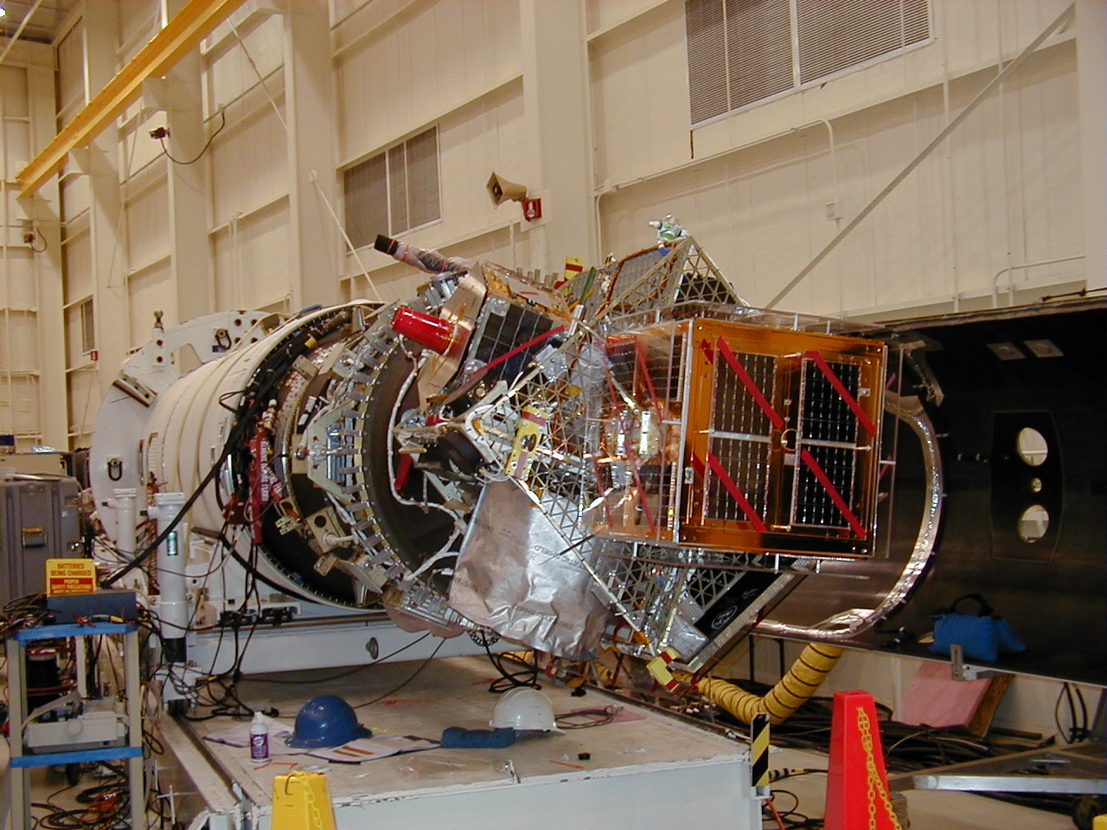
Spacecraft Launch Vehicles
OPAL on top of Taurus stage
Introduction to Space Systems and Spacecraft Design
Space Systems Design
Some Slides by Dr. J. Cutler – Univ. of MI

Slide 35
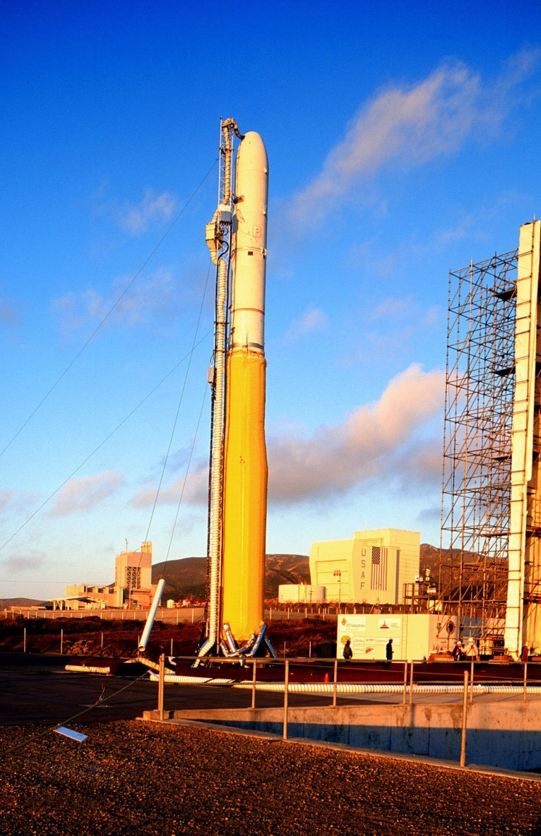
Spacecraft Launch Vehicles
Ready to go
Introduction to Space Systems and Spacecraft Design
Space Systems Design
Some Slides by Dr. J. Cutler – Univ. of MI

Slide 36
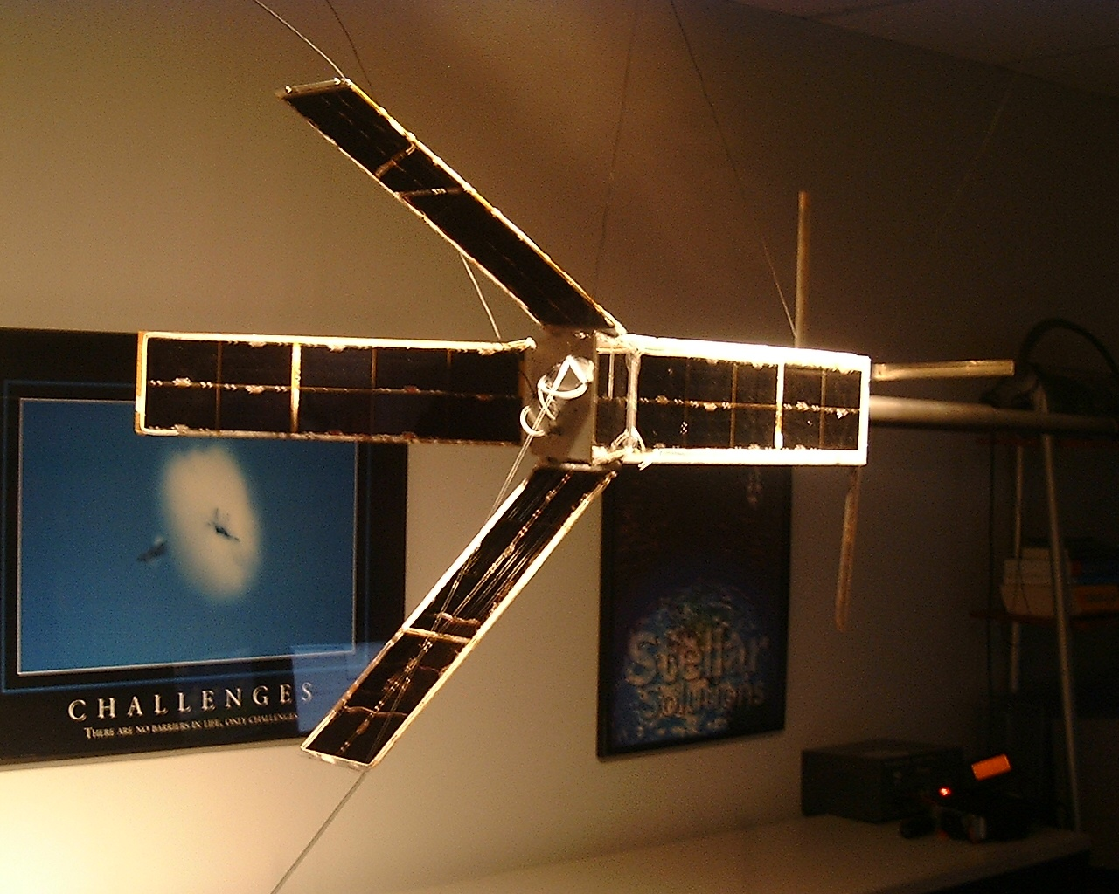
Spacecraft Launch Vehicles
QuakeSat Satellite
Introduction to Space Systems and Spacecraft Design
Space Systems Design
Some Slides by Dr. J. Cutler – Univ. of MI

Slide 37
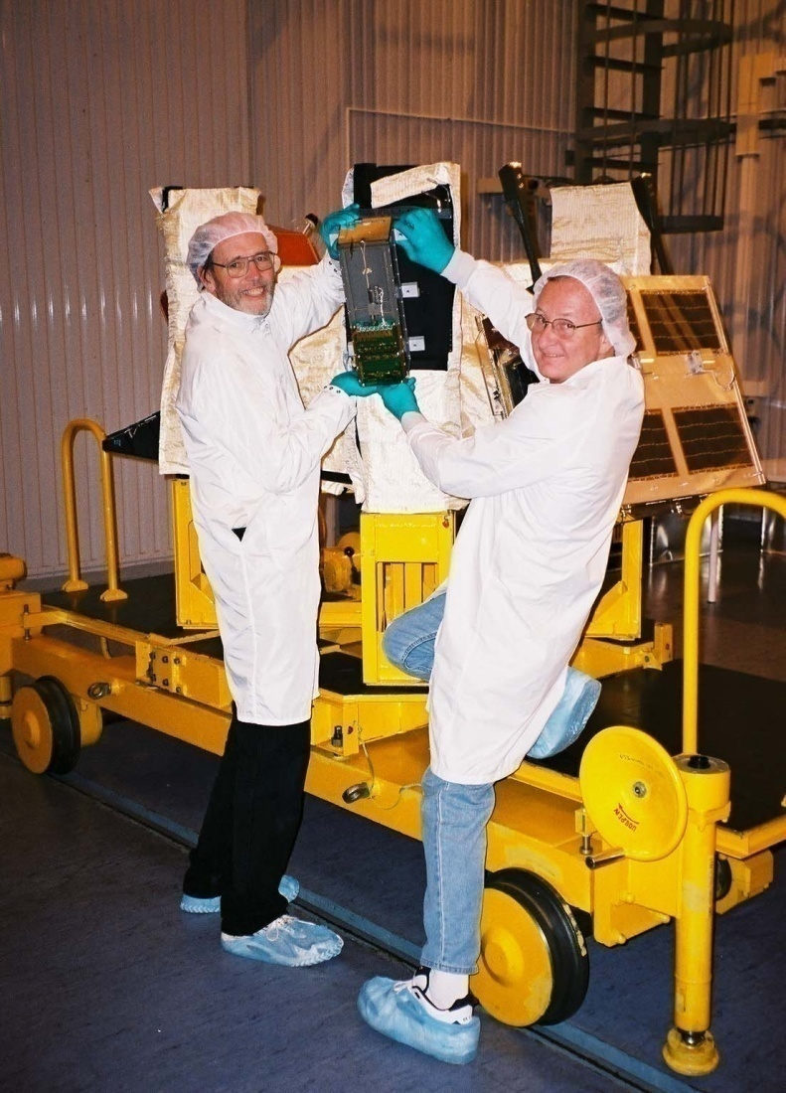
Spacecraft Launch Vehicles
At Dnepr Launch Site
Introduction to Space Systems and Spacecraft Design
Space Systems Design
Some Slides by Dr. J. Cutler – Univ. of MI

Slide 38
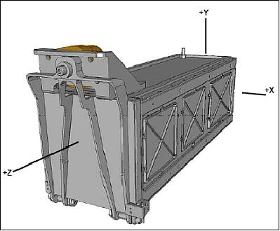
Spacecraft Launch Vehicles
CubeSat P-POD
Introduction to Space Systems and Spacecraft Design
Space Systems Design
Some Slides by Dr. J. Cutler – Univ. of MI

Slide 39
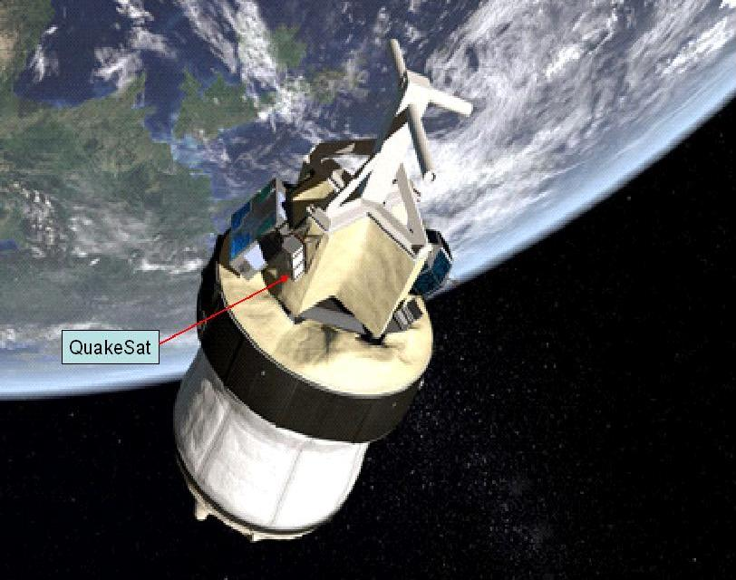
Spacecraft Launch Vehicles
Where it was mounted on Dnepr
Introduction to Space Systems and Spacecraft Design
Space Systems Design
Some Slides by Dr. J. Cutler – Univ. of MI

Slide 40
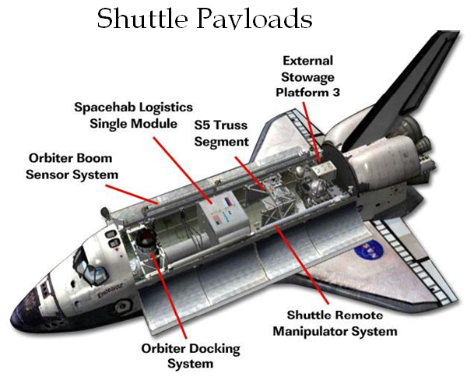
Spacecraft Launch Vehicles
Introduction to Space Systems and Spacecraft Design
Space Systems Design
Some Slides by Dr. J. Cutler – Univ. of MI

Slide 41
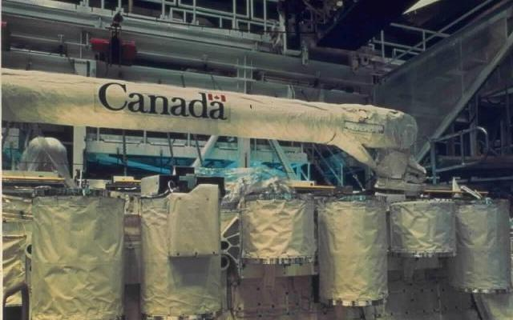

Spacecraft Launch Vehicles
Shuttle Payloads
Introduction to Space Systems and Spacecraft Design
Space Systems Design
Some Slides by Dr. J. Cutler – Univ. of MI

Slide 42
Spacecraft Launch Vehicles
Questions?
Introduction to Space Systems and Spacecraft Design
Space Systems Design
Some Slides by Dr. J. Cutler – Univ. of MI

