Slide 1
MODULE 1

Slide 2
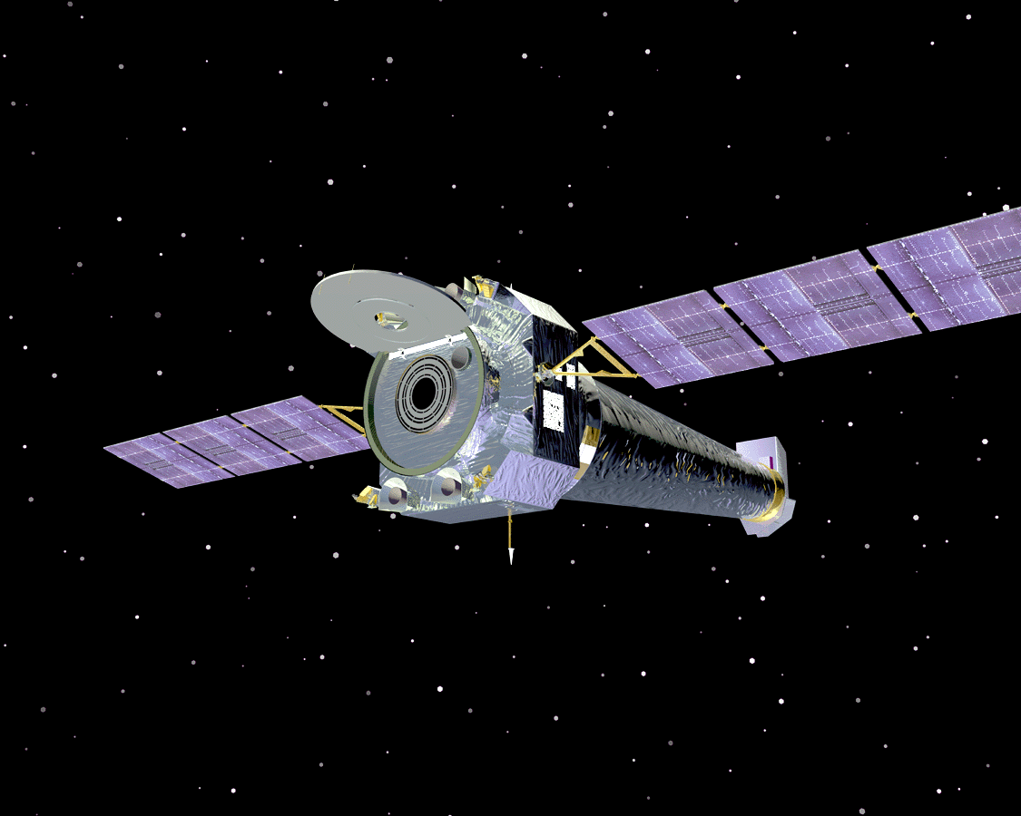
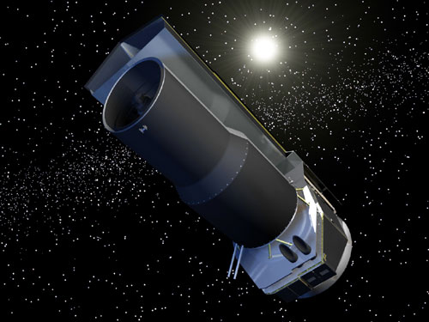
What exactly is a satellite?
The word satellite originated from the Latin word “Satellit”- meaning an attendant, one who is constantly hovering around & attending to a “master” or big man.
For our own purposes however a satellite is simply any body that moves around another (usually much larger) one in a mathematically predictable path called an orbit.
A communication satellite is a microwave repeater staion in space that is used for tele communcation , radio and television signals.
The first man made satellite with radio transmitter was in 1957.
. There are about 750 satellite in the space, most of them are used for communication.

Slide 3
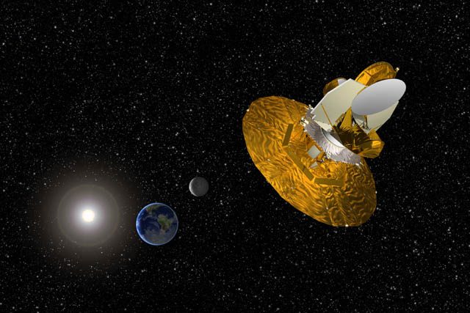
How do Satellites Work?
* Two Stations on Earth want to communicate through radio broadcast but are too far away to use conventional means.
The two stations can use a satellite as a relay station for their communication.
* One Earth Station transmits the signals to the satellite. Up link frequency is the frequency at which Ground Station is communicating with Satellite.
* The satellite Transponder converts the signal and sends it down to the second earth station. This frequency is called a Downlink.

Slide 4
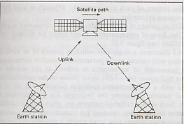
How do satellite work?

Slide 5
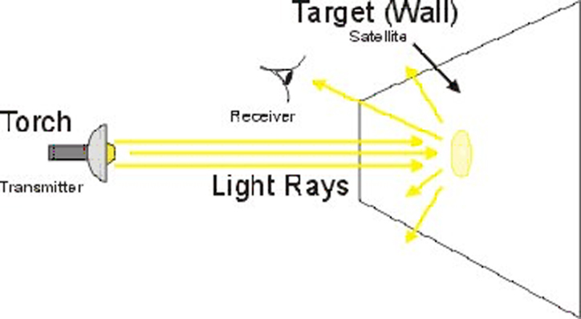
Consider the light bulb example:

Slide 6
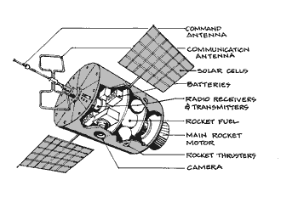
Components of a satellite

Slide 7
Advantages of satellite over terrestrial communication :
  * The coverage area of a satellite greatly exceeds that of a
  terrestrial system.
  * Transmission cost of a satellite is independent of the distance
  from the center of the coverage area.
  * Satellite to Satellite communication is very precise.
  * Higher Bandwidths are available for use.
  Disadvantages of satellites:
  * Launching satellites into orbit is costly.
  * Satellite bandwidth is gradually becoming used up.
  * There is a larger propagation delay in satellite communication
  than in terrestrial communication.

Slide 8
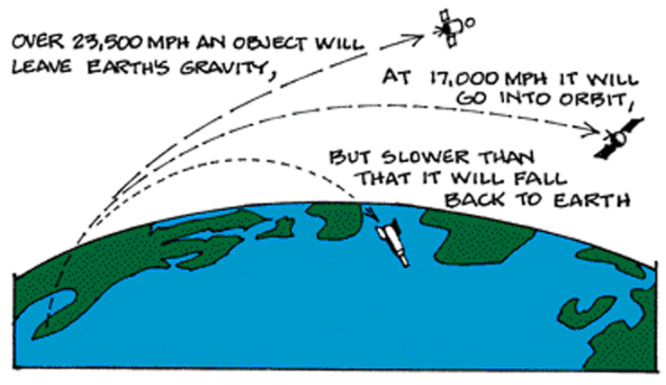
How does a satellite stay in it’s orbit?

Slide 9
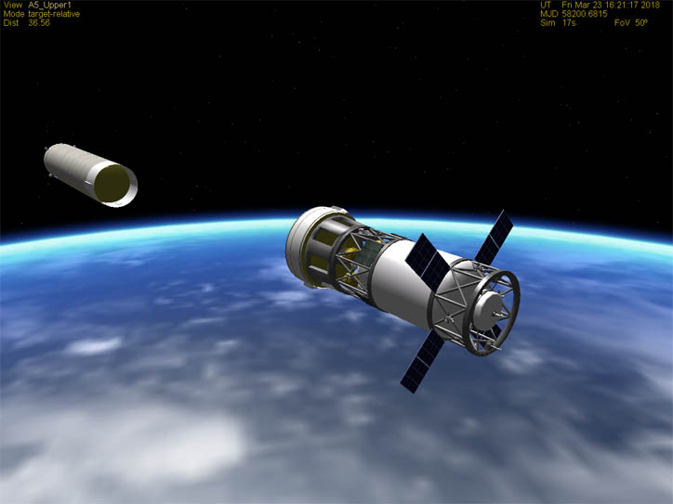
Multi-stage Rockets
Stage 1: Raises the payload e.g. a satellite to an elevation of about 50 miles.
Stage 2: Satellite 100 miles and the third stage places it into the transfer orbit.
Stage 3: The satellite is placed in its final geo-synchronous orbital slot by the AKM, a type of rocket used to move the satellite.

Slide 10
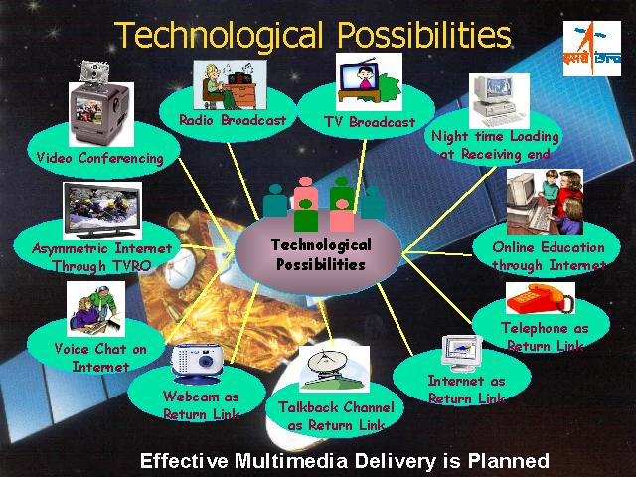
Applications

Slide 11
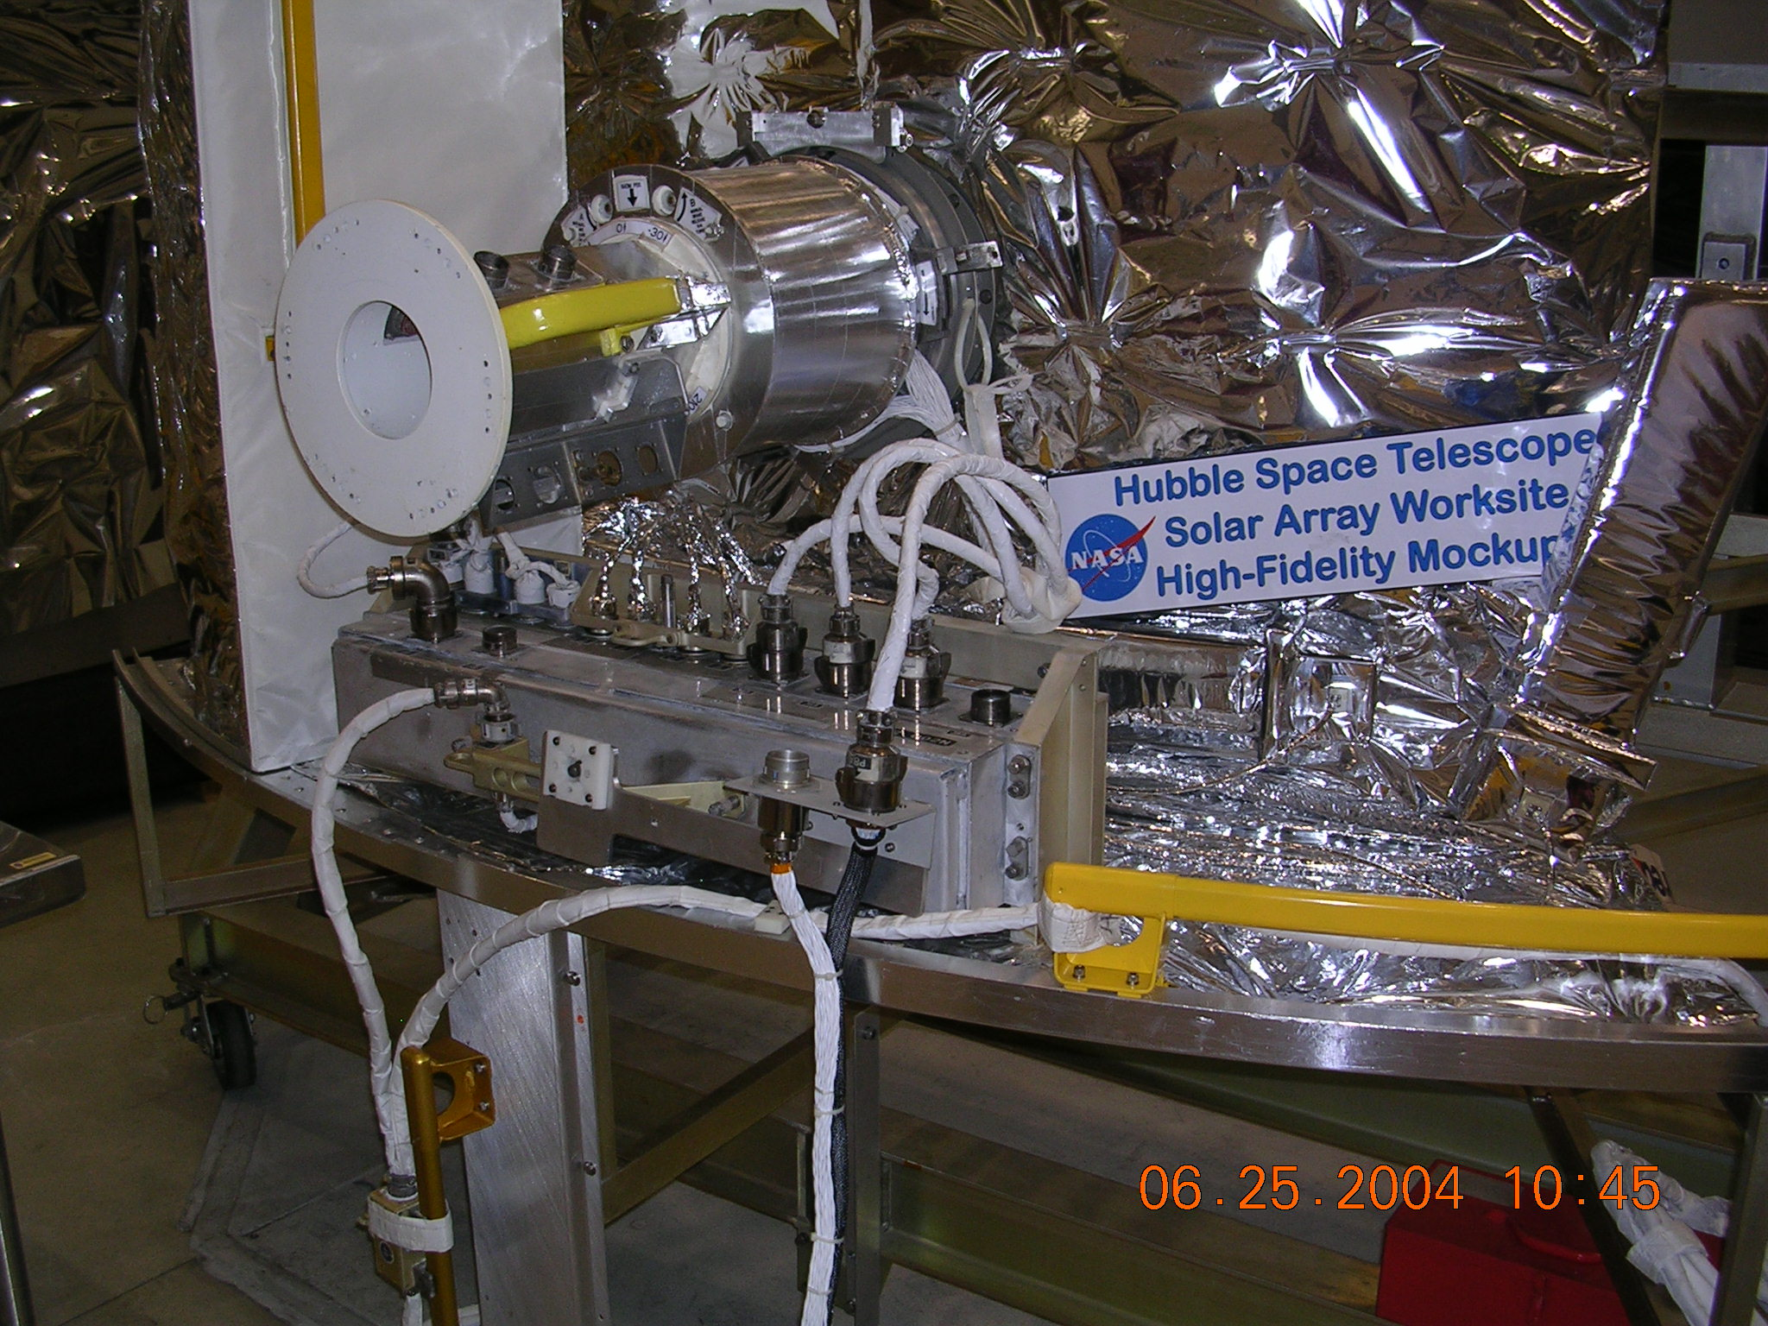
Major problems for satellites
Positioning in orbit
Stability
Power
Communications
Harsh environment

Slide 12
Positioning
This can be achieved by several methods
One method is to use small rocket motors
These use fuel - over half of the weight of most satellites is made up of fuel
Often it is the fuel availability which determines the lifetime of a satellite
Commercial life of a satellite typically 10-15 years

Slide 13
Stability
It is vital that satellites are stabilised
  - to ensure that solar panels are aligned properly, communication antennae are aligned properly
Early satellites used spin stabilisation
  - either this requires an inefficient omni-directional aerial Or antennae were precisely counter-rotated in order to provide stable communications.
  * Modern satellites use reaction wheel stabilisation - a form of gyroscopic stabilisation.

Slide 14
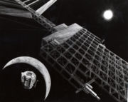
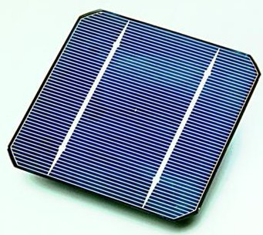
Power
Modern satellites use a variety of power means
Solar panels are now quite efficient, so solar power is used to generate electricity
Batteries are needed as sometimes the satellites are behind the earth - this happens about half the time for a LEO satellite
Nuclear power has been used - but not recommended

Slide 15
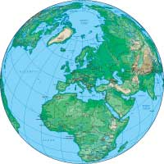
Satellite - satellite communication
It is also possible for satellites to communicate with other satellites
Communication can be by microwave or by optical laser
2.
2.
2.
1.
1.
1.
Point-Point System
Crosslink System
Hybrid System

Slide 16
Harsh Environment
Satellite components need to be specially “hardened”
Circuits which work on the ground will fail very rapidly in space
Temperature is also a problem - so satellites use electric heaters to keep circuits and other vital parts warmed up - they also need to control the temperature carefully

Slide 17
Orbits
What Is Orbit?
What Shape Is an Orbit?
How Do Objects Stay in Orbit?
Where Do Satellites Orbit Earth?

Slide 18
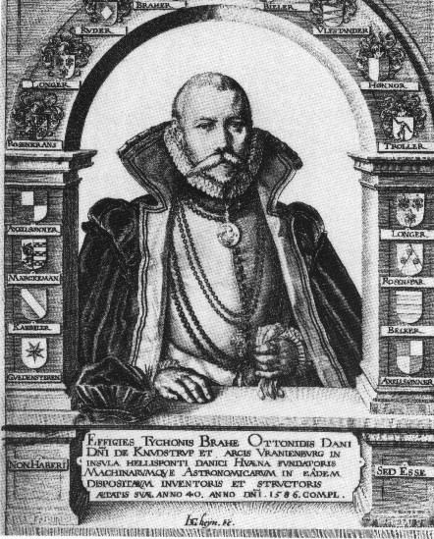
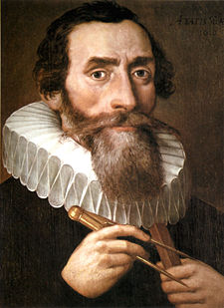
Origin of planetary laws
Sir. Johannes Keppler
Sir.Tycho Brahe
Introduced precision into astronomical measurements.
Mentor to Johannes Keppler
Derived 3 laws based
upon his observations
of planetary motion.

Slide 19
Kepler’s 1st Law: Law of Ellipses
The orbits of the planets are ellipses with the sun at one focus
Notes:
10
10

Slide 20
Kepler’s 2nd Law: Law of Equal Areas
The line joining the planet to the center of the sun sweeps out equal areas in equal times
T4
T5
T3
T2
A4
A3
T1
A5
A2
A1
T6
A6
Notes:
13
13

Slide 21
Kepler’s 3rd Law: Law of Harmonics
The squares of the periods of two planets’ orbits are proportional to each other as the cubes of their semi-major axes:
T1²/T2² = a1³/a2³
In English:
Orbits with the same semi-major axis will have the same period
Notes:
16
16

Slide 22
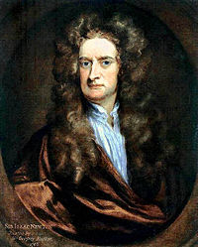
Newton’s Laws
Kepler’s laws only describe the planetary motion without attempting to suggest any explanation as to why the motion takes place in that manner.
Derived three laws of motion.
Derived the Law of Universal Gravitation.
Explained why Kepler’s laws worked.
Sir .Issac Newton

Slide 23
Newton’s 1st Law: Law of Inertia
Every body continues in a state of uniform motion unless it is compelled to change that state by a force imposed upon it
Notes:
18
18

Slide 24
Newton’s 2nd Law: Law of Momentum
Change in momentum is proportional to and in the direction of the force applied
Momentum equals mass x velocity
Change in momentum gives: F = ma
F
F
Notes:
19
19

Slide 25
Newton’s 3rd Law: Action - Reaction
For every action, there is an equal and opposite reaction
Hints at conservation of momentum
Notes:
20
20

Slide 26
Newton’s Law of Universal Gravitation
Between any two objects there exists a force of attraction that is proportional to the product of their masses and inversely proportional to the square of the distance between them
M1m2
Fg = G( )
r²
Notes:
21
21

Slide 27
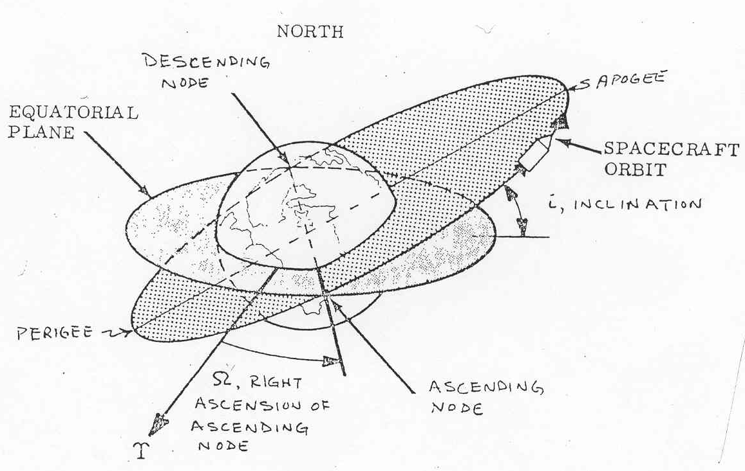
Classical orbital elements

Slide 28
Apogee and Perigee
In astronomy, an apsis is the point of greatest or least distance of the elliptical orbit of an astronomical object from its center of attraction, which is generally the center of mass of the system.
The point of closest approach is called the periapsis (Perigee) or pericentre and the point of farthest excursion is called the apoapsis (apogee)
A straight line drawn through the perigee and apogee is the line of apsides. This is the major axis of the ellipse.
Ascending & Descending nodes
These are the 2 points at which the orbit of a satellite penetrates
the equatorial plane.

Slide 29
Classical orbital elements
Six independent quantities are sufficient to describe the size, shape and orientation of an orbit.
These are
  a, the semi-major axis
  ε, the eccentricity
  i, the inclination
  Ω, the right ascension of the ascending node
  ω, the argument of perigee
  tp, mean anamoly

Slide 30
The semi-major axis describes the size of the orbit. It connects the geometric center of the orbital ellipse with the periapsis, passing through the focal point where the center of mass resides.
The eccentricity shows the ellipticity of the orbit.
The inclination is the angle between the plane of the orbit and the equatorial plane measured at the ascending node in the northward direction.
The right ascension of an ascending node is the angle between the x axis and the ascending node.
The argument of periapsis (perihelion) is the angle in the orbital plane between the line of nodes and the perigee of the orbit.
The mean anomaly is the time elapsed since the satellite passed the perigee.

Slide 31
Mean anomaly Mean anomaly M gives an average value of the angular position of the satellite with reference to the perigee.
For a circular orbit, M gives the angular position of the satellite in the orbit.
For elliptical orbit, the position is much more difficult to calculate, and M is used as an intermediate step in the calculation
True anomaly The true anomaly is the angle from perigee to the satellite position, measured at the earth’s center.
This gives the true angular position of the satellite in the orbit as a function of time.

Slide 32
Definitions of Terms for Earth-Orbiting Satellites
Apogee: The point farthest from earth (h_{a} )
Perigee: The point of closest approach to earth (h_{p} )
Line of apsides: The line joining the perigee and apogee through the center of the earth.
Ascending node: The point where the orbit crosses the equatorial plane going from south to north.
Descending node: The point where the orbit crosses the equatorial plane going from north to south.
Line of nodes:The line joining the ascending and descending nodes through the center of the earth.
Inclination The angle between the orbital plane and the earth’s equatorial plane. It is measured at the ascending node from the equator to the orbit, going from east to north.

Slide 33
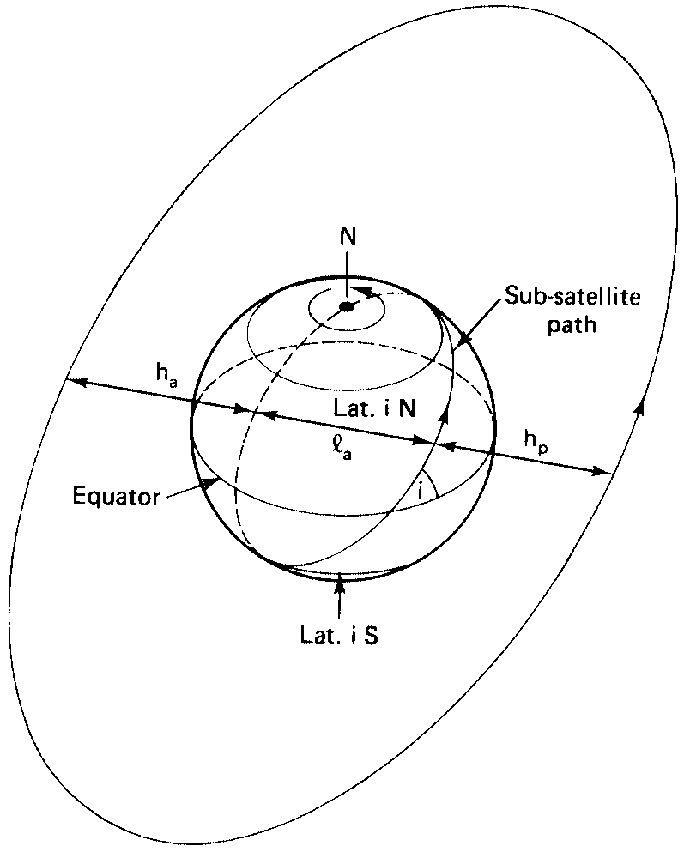

Slide 34
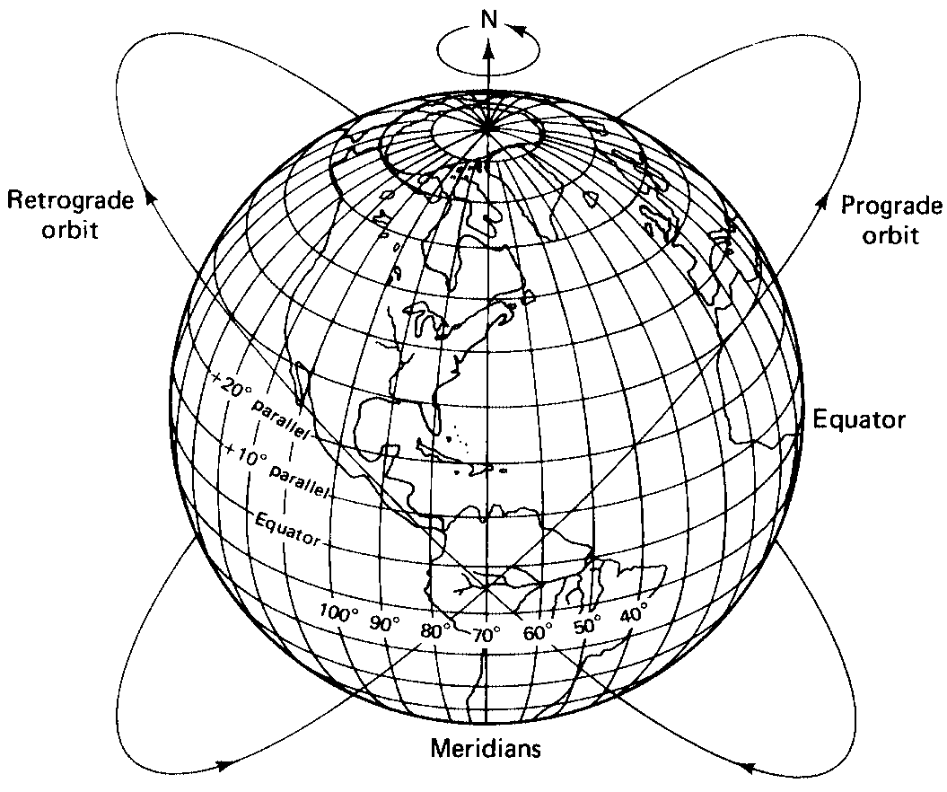
Prograde orbit An orbit in which the satellite moves in the same direction as the earth’s rotation,
Retrograde orbit An orbit in which the satellite moves in a direction counter to the earth’s rotation
Argument of perigee The angle from
ascending node to perigee,
measured in the orbital plane
at the earth’s center,
in the direction of satellite motion.

