Slide 1
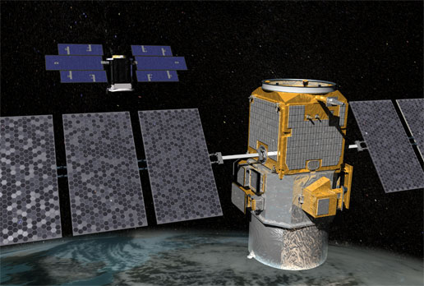
MECHANICAL STRUCTURE OF SATELLITE
Presented by
G. Hena Mercy Sugirthem
M. Sharmila

Slide 2
What is exactly a satellite ?
The word satellite originated from the Latin word “Satellit”
Which means an attendant, one who is constantly hovering around & attending to a “master” or big man.
A satellite is simply any body that moves around another (usually much larger) one in a mathematically predictable path called an orbit

Slide 3
Types of satellite orbits
Polar Orbit .
Inclined orbit .
Geostationary orbit .
Molniya orbit .
Elliptical orbit .

Slide 4
Types of satellite orbits II
Low Earth Orbit (LEO) .
Medium Earth Orbit(MEO) .
Geostationary Earth Orbit (GEO) .
High Earth Orbit (HEO) .

Slide 5
Types of satellite
Remote sensing satellite.
Images are taken and transmitted as digital data to earth stations.
Meteorological Satellites.
Satellites also act as collection and distribution points for meteorological data.
Communication satellites
They bring the world to you anywhere at any time.

Slide 6
Some of the modules of satellite
GPS antenna.
Propulsion system.
X-band antenna.
Laser Image Detection and Ranging (LIDAR) System.
Imaging infrared radiometer.
Solar panel.

Slide 7
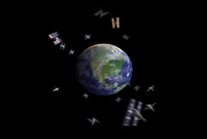
GPS antenna
A device used by GPS to transmit and receive signals.
GPS antenna is generally not exposed.
less the shape of the antenna at all.
GPS antenna is built inside the GPS navigation and plays a powerful role .

Slide 8
Propulsion system
A satellite traveling through the solar system encounters very small forces.
It is to control the position or attitude.
To stay in orbit for a long period of time some form of propulsion is occasionally necessary.

Slide 9
X-BAND antenna
"X" stands for "extended".
It is mainly designed for
high bandwidth voice,
video
data
frequency range is specified by the IEEE at 8.0 to 12.0 GHz

Slide 10
Laser Image Detection and Ranging (LIDAR) System
It consists of three major optical subsystems,
laser transmitter subsystem,
telescope subsystem
detection/receiver subsystem.
Many past and current space-borne LIDAR missions have used Nd:YAG lasers.

Slide 11
Imaging infrared radiometer
It has multi-band imaging capabilities to support the acquisition of high-resolution atmospheric imagery .
Spectral coverage from 412 nm to 12 μm in 22 bands.
It gives data about Cloud cover, cloud layers.
Cloud and aerosol physical properties.
Land & ocean biosphere properties, snow & ice.
Sea Surface Temperature, Land & Ice Temperatures and imagery.

Slide 12
Solar panel
Solar panels on spacecraft supply power for 2 main uses:
power to run the sensors, active heating, cooling and telemetry.
power for spacecraft propulsion --electric propulsion, sometimes called solar-electric propulsion.
Solar panels need to have a lot of surface area that can be pointed towards the Sun as the spacecraft moves.
More exposed surface area means more electricity can be converted from light energy from the Sun.

Slide 14
QUERIES

