Slide 1
SATELLITE ANTENNA
By,
S.Subhashini
V.Pratheeba

Slide 2
SATELLITE
A satellite is an artificial object which has been intentionally placed into orbit.
Such objects are sometimes called artificial satellites to distinguish them from natural satellites such as the moon.
Satellites are used for a large number of purposes.

Slide 3
CONT….
Common types include
Military & Civilian Earth Observation Satellites
Communications Satellites
Navigation Satellites
Weather Satellites
Research Satellites

Slide 4
ORBIT TYPES
The commonly used orbits are
Low Earth Orbit (LEO),
Medium Earth Orbit (MEO)
Geosynchronous Earth Orbit (GEO)

Slide 5
ANTENNA USED IN SATELLITE
Basically four main type of antennas are used:
Monopoles and Dipoles (wire antennas)
Horn antennas
Array antennas (phased array antennas )
Reflector antennas

Slide 6
IRIDIUM SATELLITE SYSTEM
The Iridium satellite constellation is a large group of satellites providing voice and data coverage to satellite phones, pagers and integrated transceivers over Earth's entire surface.
The constellation consists of 66 active satellites in orbit, and additional spare satellites to serve in case of failure.

Slide 7
CONT..
The constellation of 66 active satellites has 6 orbital planes spaced 30 degrees apart, with 11 satellites in each plane.
Satellites are in Low Earth Orbit at a height of approximately 781 km and inclination of 86.4°.
Satellites communicate with neighboring satellites via Ka band inter-satellite links.

Slide 8
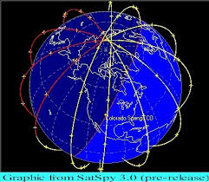
.

Slide 9
CONT..
Each satellite can have four inter-satellite links:
two to neighbors fore and aft in the same orbital plane
two to satellites in neighboring planes to either side
Each satellite completely orbits the earth in 100 minutes traveling at 16,832 miles per hour and from horizon to horizon it takes 10 minutes.

Slide 10
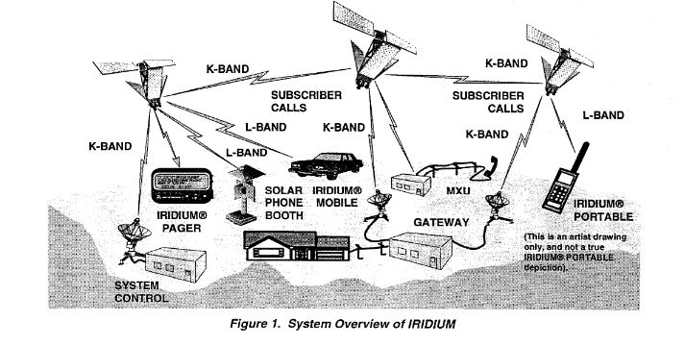
OVERVIEW OF IRIDIUM

Slide 11
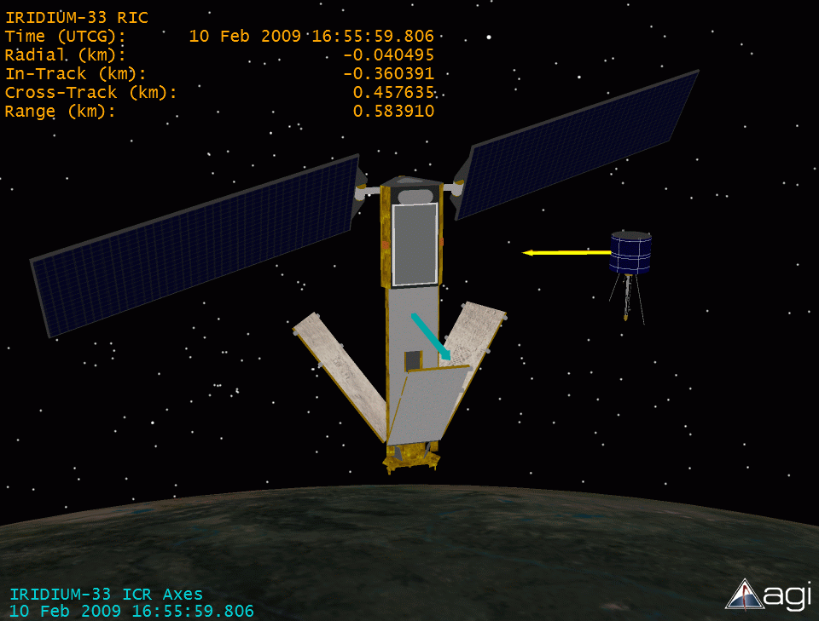
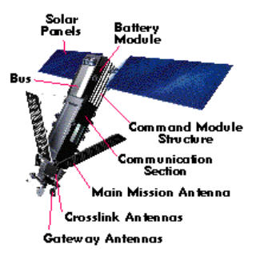
IRIDIUM SATELLITE

Slide 12
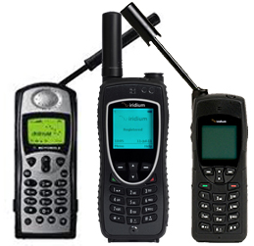
IRIDIUM SATELLITE PHONE

Slide 13
THANK YOU

