Slide 1
TELEMETRY,TRACKING AND COMMAND SYSTEM
Presented by
V.Kokila
I.Nancy

Slide 2
Telemetry & monitoring
A system that reliably and transparently conveys measurement information from a remotely located data generating source to users located in space or on Earth.
The sensors inside satellite collect data about the satellite health & report it back to Earth by telemetry system & the monitoring systems on Earth station analyze this data.

Slide 3
Tracking
A system that observes and collects data to plot the moving path of an object.
The Earth station detects the current position of satellite by tracking system.

Slide 4
Command system
A system by which control is established and maintained.
It is used to control the firing of motors during launch & for maneuver control & operate the communication system by giving commands from Earth station

Slide 5
TELEMETRY,TRACKING AND COMMAND SYSTEM
Satellite TT&C subsystem is an important and indeed essential subsystem in a satellite.
Tracking is to know the satellite on ground
Telemetry is to obtain satellite information on ground
Command is to active satellite operation on ground

Slide 6
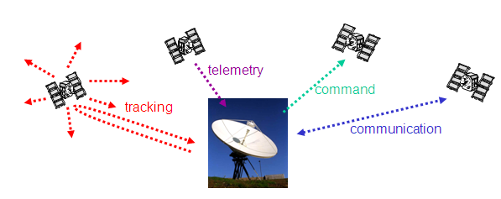
VIEW OF TT&C

Slide 7
THANK YOU

